Slide 1
Model Uncertainty
Using Probabilistic Machine Learning

Slide 2
Uncertainty
http://mlg.eng.cam.ac.uk/yarin/blog_3d801aa532c1ce.html
https://arxiv.org/pdf/1703.04977.pdf
https://alexgkendall.com/computer_vision/bayesian_deep_learning_for_safe_ai/
Epistemic vs Aleatoric uncertainty
Not enough data vs not enough features
Important in risk averse domains (medicine, finance, self-driving cars, …)
Able to tell “I don’t know”

Slide 3

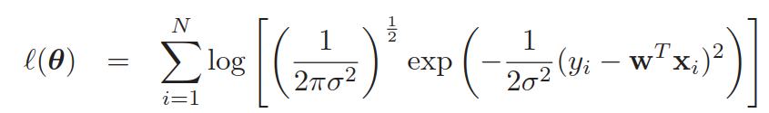
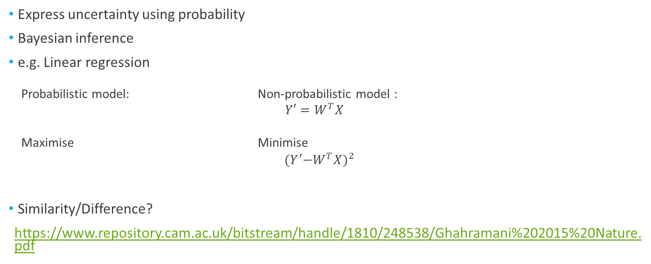
Probabilistic Machine Learning
Express uncertainty using probability
Bayesian inference
e.g. Linear regression
Probabilistic model: Non-probabilistic model :
$Y′=W^{T}X$
Maximise Minimise
$${{(Y}^{′}−W^{T}X)}^{2}$$
Similarity/Difference?
https://www.repository.cam.ac.uk/bitstream/handle/1810/248538/Ghahramani%202015%20Nature.pdf

Slide 4
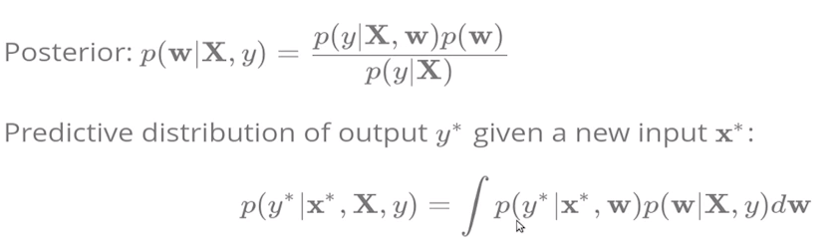

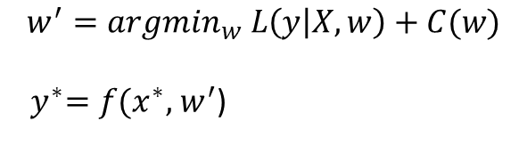
Bayesian inference
Non-Bayesian: Bayesian:
Similarity/Difference
L = Loss function <-> Likelihood
C = Complexity <-> Prior
Point estimates ($w^{′}$) vs Distributions ($p(w|X,y)$)
Likelihood
Prior
$$w^{′}={argmin}_{w} L\left(y | X,w\right)+C(w)$$
${ y}^{∗}=f(x^{∗},$ $w^{′}$)

Slide 5
Bayesian methods
Sampling (MCMC) vs optimisation (SGD)
MCMC: https://chi-feng.github.io/mcmc-demo/app.html#RandomWalkMH,banana
SGD: https://bl.ocks.org/EmilienDupont/aaf429be5705b219aaaf8d691e27ca87

Slide 6
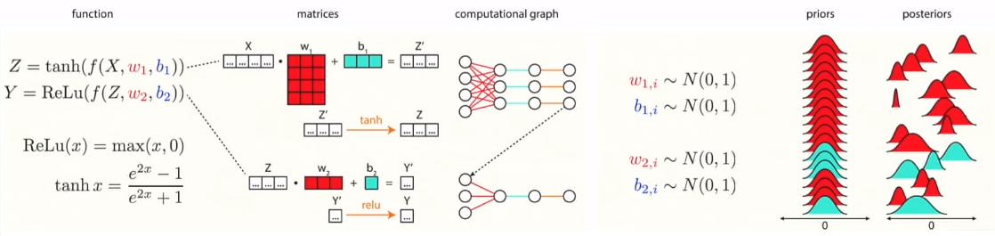
Bayesian Deep Learning
NIPS: http://bayesiandeeplearning.org/index.html
Image taken from https://www.youtube.com/watch?v=s0S6HFdPtlA

Slide 7
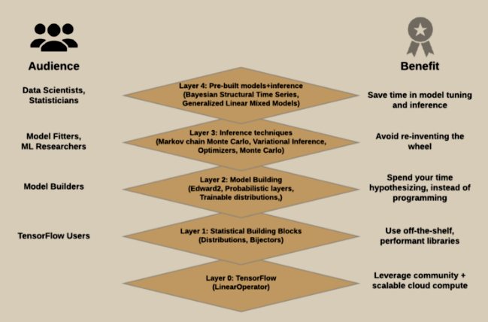
Tensorflow Probability
Probabilistic programming
Build a generative (not discriminative) model of data, reasoning about its hidden processes.
i.e. P(Y, X) instead of P(Y|X)
Quantify the uncertainty in predictions
https://www.tensorflow.org/probability/
https://medium.com/tensorflow/introducing-tensorflow-probability-dca4c304e245

Slide 8
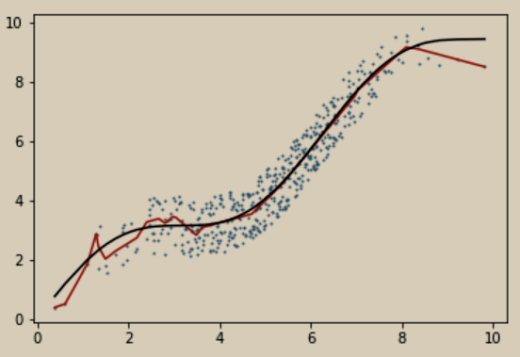
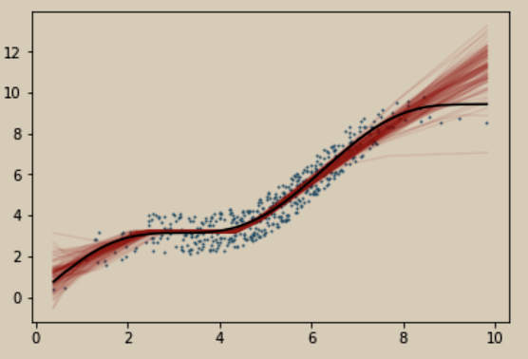
Tensorflow Probability
Toy example
Non-Bayesian NN Bayesian NN

Slide 9
Potential applications
ETA on port pairs with few data points
…

Slide 10
More readings
Machine Learning: A Probabilistic Perspective
Bayesian Methods for Hackers: Probabilistic Programming and Bayesian Inference
Dropout as a Bayesian Approximation: Representing Model Uncertainty in Deep Learning
Bayesian Layers: A Module for Neural Network Uncertainty

